Slide 1

Analysis of Washington Crime Data
Department of Applied Data Science, San Jose State University
Professor: Andrew Bond
Presented By,
Tirth S. Patel

Slide 2

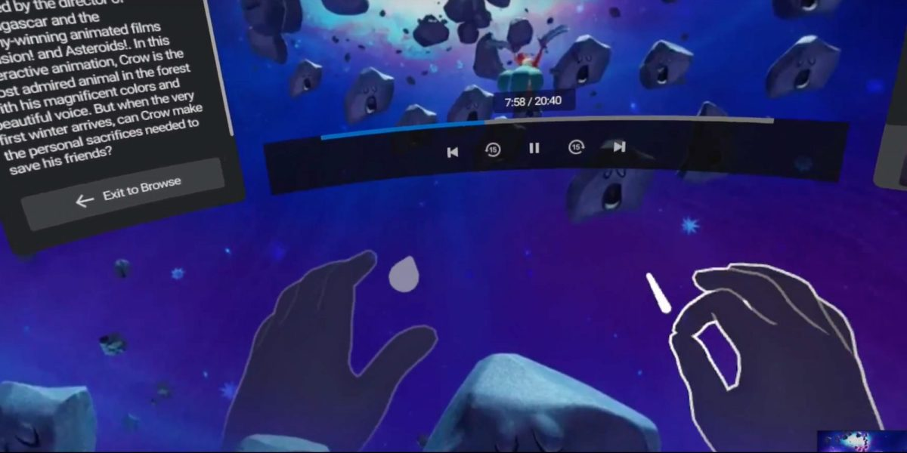
Overview
• Punishable by possible incarceration
• Collected and maintained by Summary Reporting System (SCR) (1930 - 2018)
• Detailed Collection and maintained by National Incident Based Reporting System (NIBR) (2012 -present)
• Compiled via officer report writing system
• Adjusted/corrected by Police Administrative Staff
• State report published by Washington Association of Sheriffs and Police Chiefs (WASPC) and Washington Statistical Analysis Center (WSAC)

Slide 3

About the Dataset
● AGGRAVATED ASSAULT - An unlawful attack by one person upon another for the purpose of inflicting severe or aggravated bodily injury. This type of assault usually is accompanied using a weapon or by means likely to produce death or great bodily harm.
● ARSON: The willful or malicious burning, or attempt to burn, with or without intent to defraud, a dwelling house, public building, motor vehicle or aircraft, personal property of another.
● BURGLARY: The unlawful entry, or attempted entry, of a structure to commit a felony or a theft.
● MURDER: The willful killing of one person by another or the killing of another person through gross negligence. Also includes the non-violent offense of Controlled Substance Homicide. Summary Reporting System Data Definitions Washington State Statistical Analysis Center 2 Updated on October 27, 2018
● MVTHEFT: The theft or attempted theft of a motor vehicle.

Slide 4
About the Dataset
● POPULATION: The total population for the jurisdiction of the agency, as reported by the agency. • PRATE: Number of property crimes per 1,000 residents.
● PTOTAL: Total number of property crimes reported including burglary, theft, motor vehicle theft, and arson.
● RAPE: The carnal knowledge of a female forcibly and against her will. Also includes attempts to commit forcible rape.
● RATE: Number of crimes committed per 1,000 residents.
● ROBBERY: The taking or attempting to take anything of value from the care, custody, or control of a person or persons by force or the threat of force or violence and/or by putting the victim in fear.
● TOTAL: Total number of crimes reported by the law enforcement agency.
● VRATE: Number of violent crimes committed per 1,000 residents.

Slide 5
About the Dataset
● VTOTAL: Total number of violent crimes reported including murder, rape, robbery, and aggravated assault.
● ANIMAL_CRUELTY: Intentionally, knowingly or recklessly taking an action that mistreats or kills any animal without just cause. Included are instances of failure of duty to provide care (food, water, shelter, vet); transporting/confining an animal in a way likely to cause injury/death; causing an animal to fight with another; inflicting excessive or repeated pain/suffering.
● ARSON: To unlawfully and intentionally damage or attempt to damage any real or personal property by fire or incendiary device.

Slide 6
About the Dataset
● ASSAULT: Includes the following offenses:
• Aggravated Assault: An attack wherein the offender uses a weapon or displays it threateningly or the victim suffers obvious severe bodily injury and attempts to murder.
• Simple Assault: A physical attack where no weapon is displayed, and the victim does not suffer any obvious or suspected severe injury such as those in aggravated assaults.
• Intimidation: To place another person in reasonable fear of bodily harm using threatening words and/or other conduct but without displaying a weapon or subjecting the victim to actual attack. Includes stalking.
● BRIBERY: The offering, giving, receiving, or soliciting of anything of value to sway the judgment or action of a person in a position of trust or influence.
● BURGLARY: The unlawful entry into a building or other structure with the intent to commit a felony or theft.

Slide 7
About the Dataset
● COUNTERFEITING_FORGERY: The altering, copying or imitation of something, without authority or right, and passing, selling, buying, or possessing with the intent to deceive or defraud.
● DESTRUCTION_OF_PROPERTY: To destroy willfully or maliciously, damage, deface or otherwise injure real or personal property without the consent of the owner or person having custody.
● DRUG_VIOLATIONS: Includes the following offenses:
• Drug/Narcotic Violations: The unlawful cultivation, manufacture, distribution, sale, purchase, use, possession, transportation or importation of any controlled drug or narcotic substance. Excludes DUIs.
• Drug Equipment Violations: The unlawful manufacture, sale, purchase, possession or transportation of equipment or devices utilized in preparing and/or using drugs or narcotics.

Slide 8
About the Dataset
● EXTORTION_BLACKMAIL: To unlawfully obtain money, property or any other thing of value through the use of threat of force, misuse of authority, threat of criminal prosecution, threat of destruction of reputation or through other coercive means.
● FORCIBLE_SEX: Includes the following offenses:
• Forcible Rape: The carnal knowledge of a person, forcibly and/or against that person’s will.
• Forcible Sodomy: Oral or anal sexual intercourse with another person, forcibly and/or against that person’s will.
• Sexual Assault with an Object: To use an object to unlawfully penetrate the genital or anal opening of the body of another person, forcible and/or against that person’s will.
• Forcible Fondling: The touching of the private body parts of another person for the purpose of sexual gratification, forcibly and/or against that person’s will.

Slide 9
About the Dataset
● GAMBLING_VIOLATIONS: Includes offenses for Betting/Wagering, Operating/ Promoting/Assisting Gambling, Gambling Equipment Violations and Sports Tampering.
● HUMAN_TRAFFICKING: Includes the following offenses:
• Commercial Sex Acts – Inducing a person by force, fraud, or coercion to participate in commercial sex acts or in which the person induced to perform such acts has not attained 18 years of age.
• Involuntary Servitude – Obtaining of a person through recruitment, harboring, transportation, or provision and subjecting such person by force, fraud or coercion into involuntary servitude, peonage, debt bondage or slavery (not to include commercial sex acts).
● KIDNAPPING_ABDUCTION: Unlawful seizure, transportation and/or detention of a person against his/her will or of a minor without the consent of his/her custodial guardian. Includes hostage-taking.

Slide 10
About the Dataset
● MANSLAUGHTER: Negligent Manslaughter is the killing of another person through negligence. Excludes Vehicular Manslaughter.
● MURDER: The willful killing of one person by another or the killing of another person. Includes Nonnegligent Manslaughter. Note: attempted murders are reported as Aggravated Assaults.
● NON_FORCIBLE_SEX: Includes the following offenses:
• Incest: Non-forcible sexual intercourse between persons who are related to each other within the degree where in marriage is prohibited by law.
• Statutory Rape: Non-forcible sexual intercourse with a person who is under the statutory age of consent.
● POPULATION: The total population for the jurisdiction of the agency, as reported by the agency.
● PORNOGRAPHY: The violation of laws or ordinances prohibiting the manufacture, publishing, sale, purchase, or possession of sexually explicit material.

Slide 11
About the Dataset
● PROSTITUTION: Includes the following offenses:
• Prostitution: To unlawfully engage in or promote sexual activities for profit.
• Assisting or Promoting Prostitution: To solicit customers or transport persons for prostitution purposes; to own, manage or operate an establishment for the purpose of providing a place where prostitution is performed; to otherwise assist or promote prostitution.
• Purchasing Prostitution: To purchase or trade anything of value for commercial sex acts.
● PRPRTYRATE: Number of property offenses reported per 1,000 residents.
● PRPRTYTOTAL: Total number of property offenses reported including arson, bribery, burglary, counterfeiting and forgery, destruction of property, extortion/blackmail, robbery, and theft.
● PRSNRATE: Number of person offenses reported per 1,000 residents.

Slide 12
About the Dataset
● PRSNTOTAL: Total number of person offenses reported including murder, manslaughter, forcible sex, assault, intimidation, non-forcible sex, kidnapping/abduction, violation of a no-contact order and human trafficking.
● RATE: Number of offenses committed per 1,000 residents.
● ROBBERY: The taking or attempting to take anything of value from the care, custody, or control of a person or persons by force or the threat of force or violence and/or by putting the victim in fear.
● SCTYRATE: Number of society crimes per 1,000 residents.
● SCTYTOTAL: Total number of society offenses reported including drug violations, gambling violations, pornography/prostitution, weapon law violations, and animal cruelty.

Slide 13
About the Dataset
● THEFT: Includes the following offenses:
• Embezzlement: The unlawful misappropriation by an offender to his/her own use or purpose of money, property or some other thing of value entrusted to his/her care, custody, or control.
• Fraud: The intentional perversion of the truth for the purpose of inducing another person or entity in reliance upon it to part with something of value or surrender a legal right. Includes offenses for False Pretense/Swindle/Confidence Game, Credit Card/ATM Machine Fraud, Impersonation, Welfare Fraud and Wire Fraud.
• Larceny: Includes offenses for Pocket-picking, Purse-snatching, Shoplifting, Theft From a Building, Theft From Coin-Operated Machine or Device, Theft From Motor Vehicle, Theft of Motor Vehicle Parts or Accessories, All Other Thefts.
• Motor Vehicle Theft: The theft of a motor vehicle as defined as a self-propelled vehicle that runs on the surface of land and not on rails.
• Stolen Property Offenses: Receiving, buying, selling, possessing, concealing, or transporting any property with the knowledge that it has been unlawfully taken.

Slide 14
About the Dataset
● TOTAL: Total number of offenses reported by the law enforcement agency.
● VIOL_OF_NO_CONTACT: All violations of court ordered no-contact, protection, restraining or anti-harassment orders. May not be domestic violence related.
● WEAPON_LAW_VIOLATIONS: The violation of laws prohibiting the manufacture, sale, purchase, transportation, possession, concealment or use of firearms, cutting instruments, explosives, incendiary devices or other deadly weapons.

Slide 15

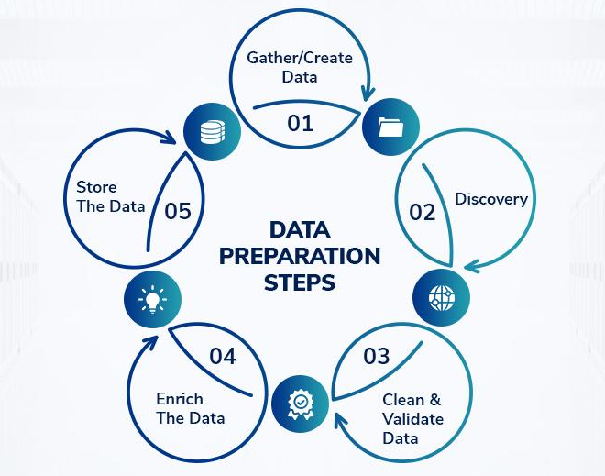
Project Data Preparation
Data preparation has been done using the tableau prep builder.
Merged or Aggregated certain fields to being data from the two sources to common form.
Renamed fields to common convention from two sources
Adjusted null values and removed unnecessary fields from the data.
Filtered data having common date range.
Grouped common crime data.
Changed Values to bring fields from different data sources to same form.
Created calculated fields as required for the analysis

Slide 16
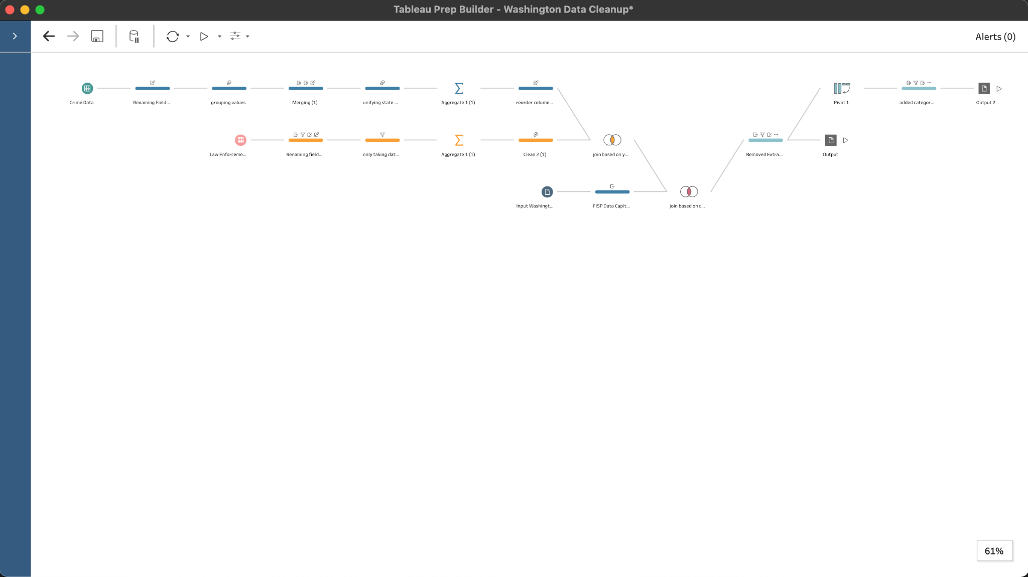
Project Data Preparation
Data was cleaned and merged using Tableau Prep Builder.
Multiple formats of data was created as per the requirement for the analysis.

Slide 17

Visualizations Created for the Analysis
Total Crimes in Counties
Highest Crime Reported in an Year
Analysis of Crime Trend in Washington State
Change in population to change in crime
Gender to Crime relation
Females & Sex Crime
Average Crimes by category in each county
Average Law Enforcement Strength per county
Change in Law Enforcement strength over time
Change in Law Enforcement Strength and Crime
Change in Law-enforcement affect to crime
Crime Summary per county
Change in Categorised Crime over period
Summary of Categorised Crime over the period

Slide 18


Visualizations on Tableau

Slide 19


Slide 20
Thank You!

